Slide 1
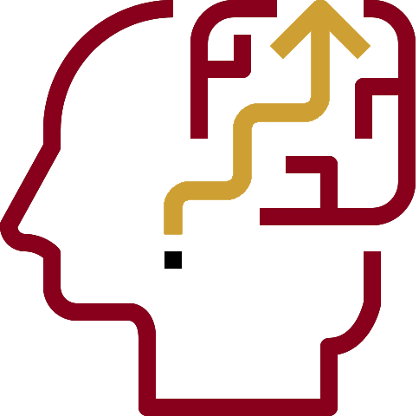
Evidence-centered Classroom Assessment Design (ECCA)
Russell Almond, James A. Hernandez and Jeannine E. Turner
Educational Psychology and Learning Systems, FSU FERA November 2019
Notes:
We have adapted the work that Dr. Almond and his colleagues have been doing with ECD over the last 25 years and are bringing it to the classroom.

Slide 2
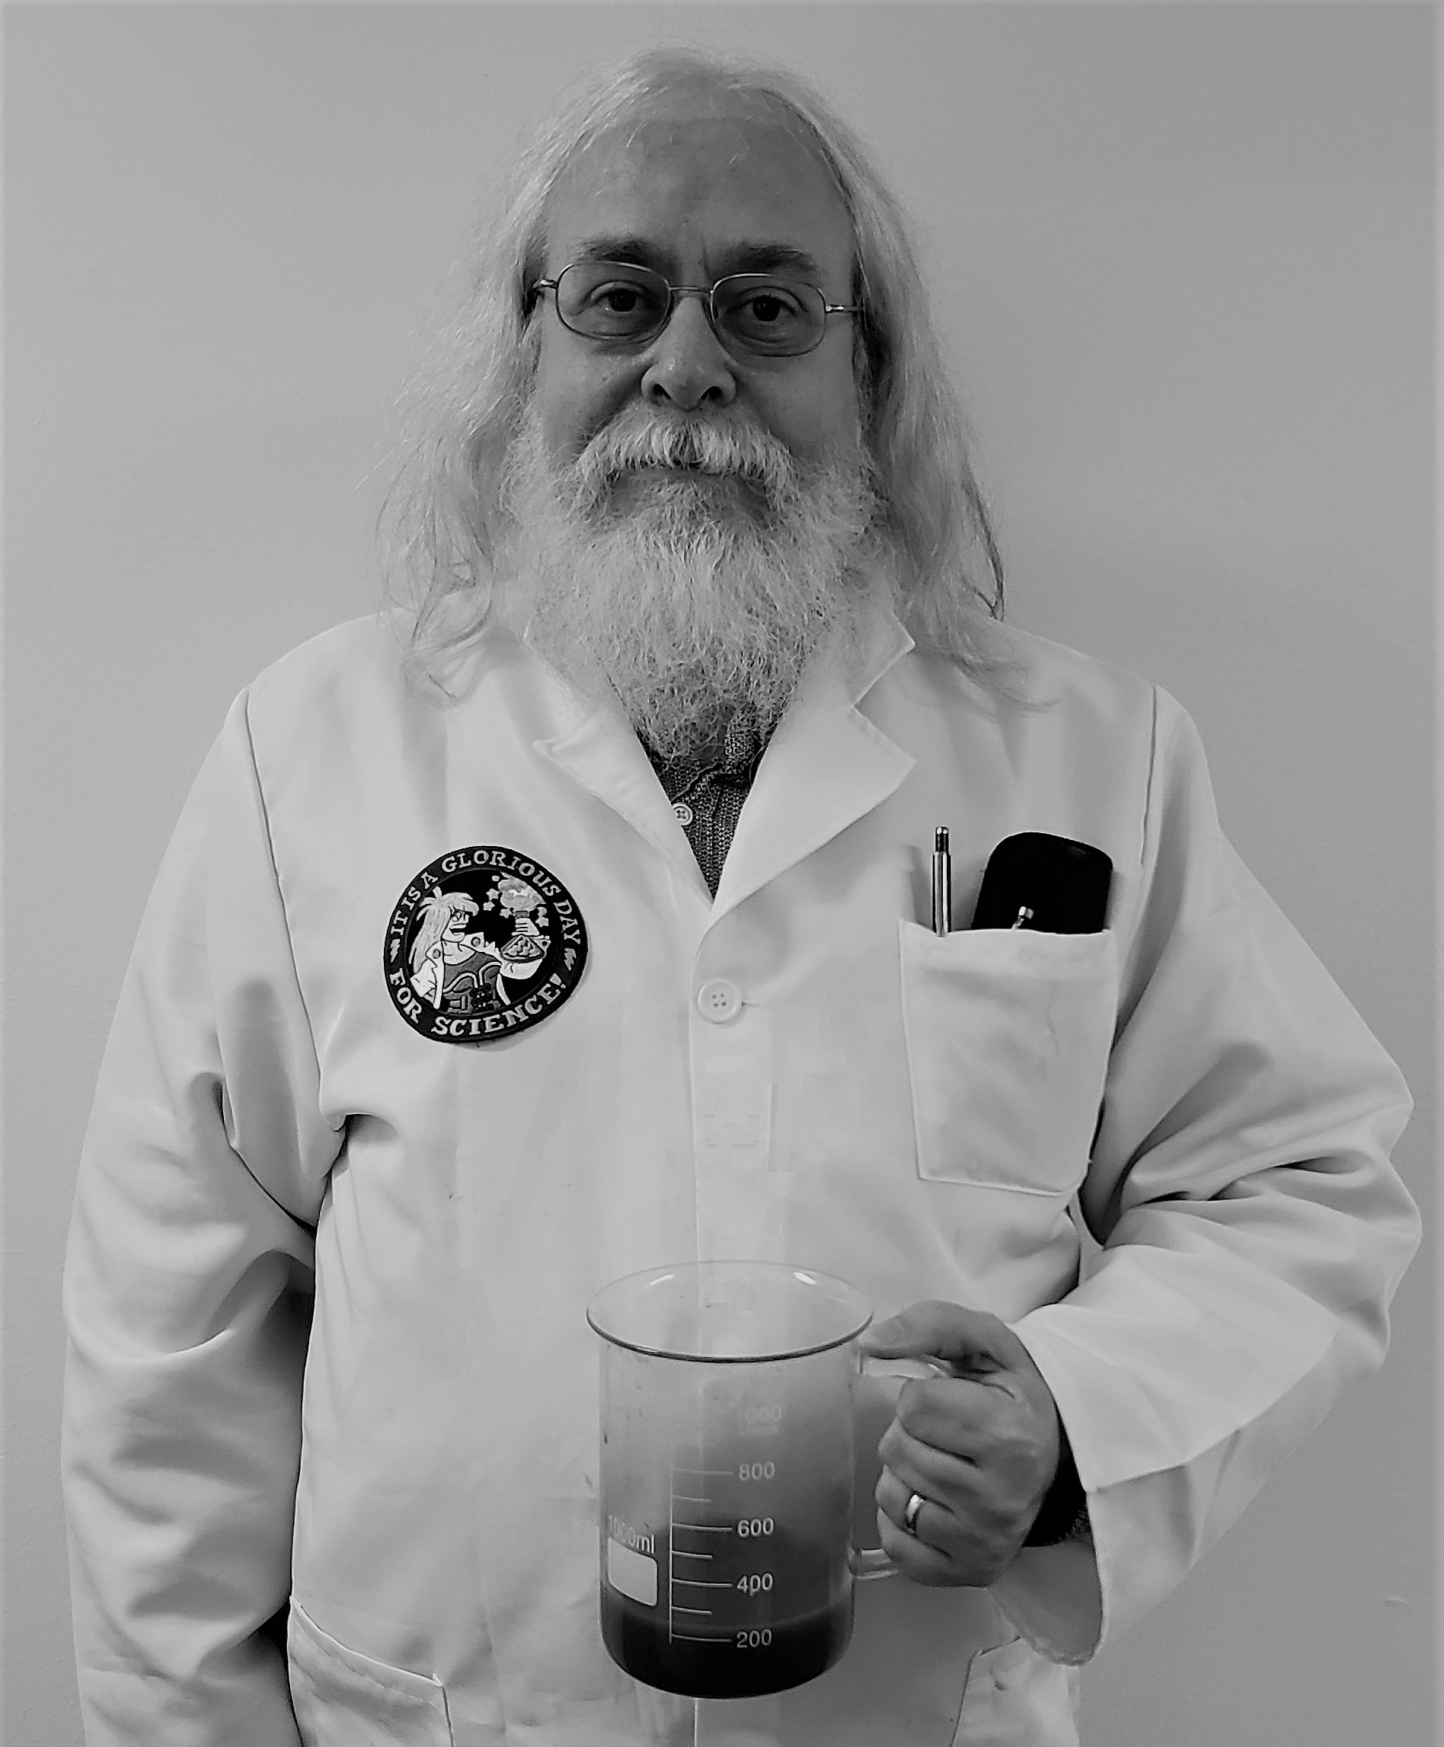
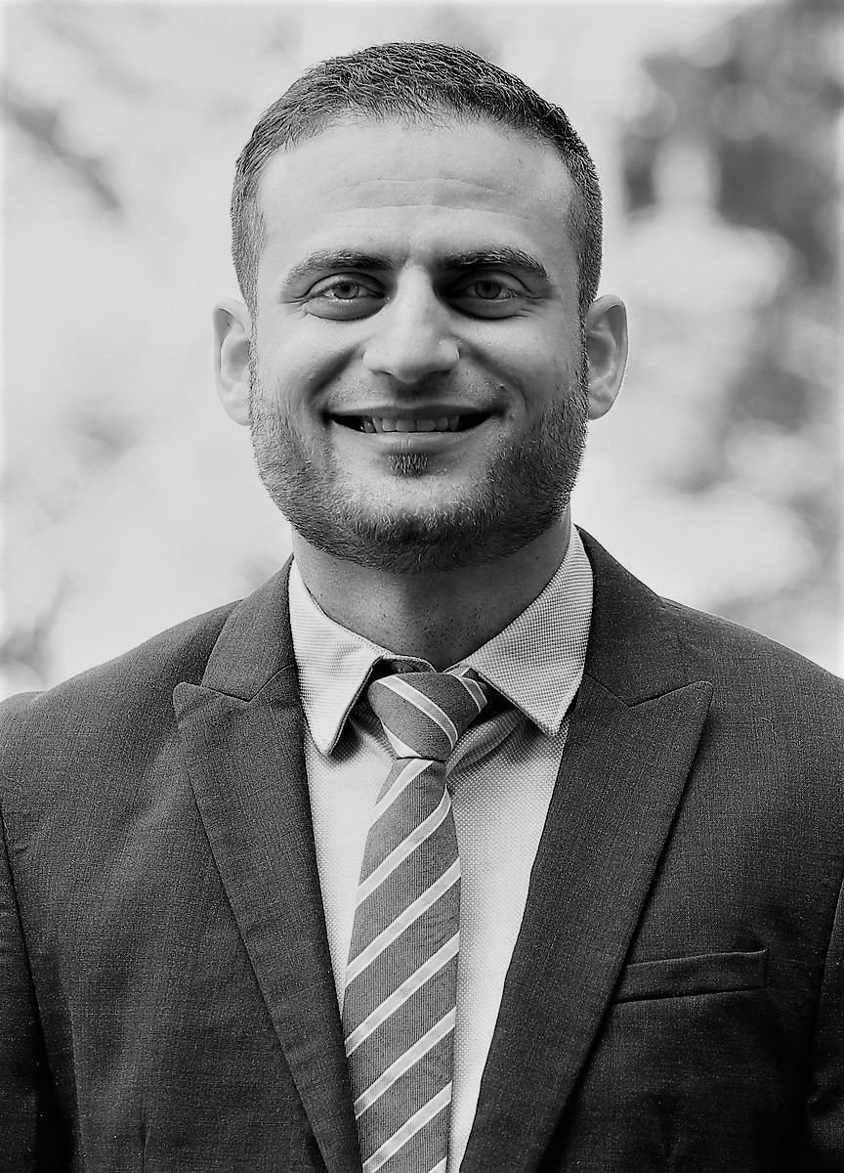
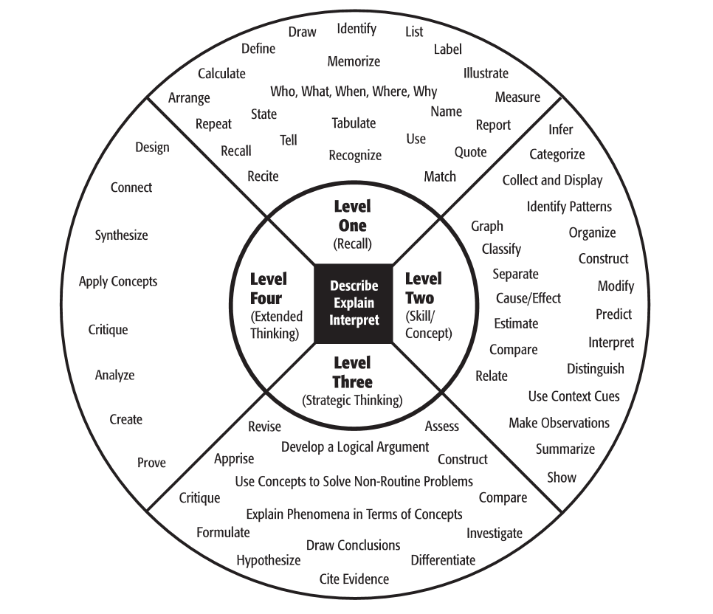
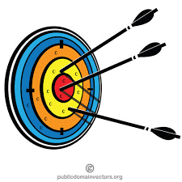
Who?
R
T
Collaborating to Calibrate Teaching
Assessment Mastermind!
Associate Professor, Statistician, esearcher,
Superhero Skills:
Evidenced Centered Assessment Design, Father of twin teenage daughters
Teacher
Version 1.0
Former 5th Grade eacher,
Novice researcher
Superhero Skills:
Teacher Support,
Pugdaddy
T
R
Notes:
T- First we are formatting this presentation as a dialogue and discussion where Dr. Almond will be playing his role as Assessment Mastermind aka the Researcher and I will be playing the role as a teacher.
Having our feet in both the research and teaching world, our hopes are to be able to help teachers teach what they intend on teaching so that students are learning the skills and standards we want them to master!
We have made examples based on lesson plans templates, I used in 14/15 as a 5th grade teacher in Florida so we hope they are still relevant but if they aren’t please let us know.

Slide 3
What?
Assessment/
Lesson Plan
Revise Plan
Do Activity
Skill
Scale
Activity Scope
Gather
Evidence
Identify Evidence
Evidence Rubric
Evidence-centered Classroom Assessment Design (ECCA) is assisting educators in aligning their target learning standards to their pedagogical practices and assessments
Notes:
T- “What is Evidence-centered Classroom Assessment Design (ECCA)?
R- it is assisting educators in aligning their target learning standards to their pedagogical practices and assessments
It is the life cycle of a lesson/unit and you can start at any point of the cycle and when you are enacting the plan you are going clockwise in the cycle.

Slide 4
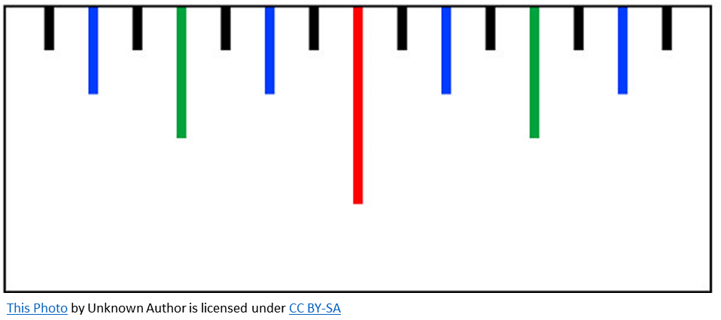
Why?
Optimal Learning
Too Easy
Too Demanding
Each student is unique!
The Optimal Learning Zone, it is unique and constantly moving for each student.
Constant Formative Assessments and Scaffolding the activity/task to be easy enough to try but demanding enough for the student to learn.
Notes:
Why? Because each student is unique, and as educators we are trying to find the the optimal learning zone, it is unique and constantly moving for each student.
Vygotsky calls this the Zone of Proximal Development, You technically want the student to have a 50/50 chance of succeeding in the task and if they fail adjusting the task so that they can succeed. (not sure I want the 50/50 comment
We want to be constantly formatively assessing the students and scaffolding activites to be easy enough for the students to try but demanding enough for the students to learn.
T- Warning, this requires creating a classroom environment/climate and culture that is explicit about growth mindset and that we learn most from failure. That as a class we are here to help each other learn.
Optimal learning zone, has roots in Hunt 1961, Ausubel 1963 and Brophy 1976 pp. 62 “ Learning will be most optimal when presented at the optimal difficulty level”- in which Dr. Almond may have found how to test for it, and created a system to maintain it.

Slide 5
Ask 4 Questions
How?
1. What are we measuring?
2. How are we measuring?
3. Where are we measuring?
4. How much are we measuring?
Skills
Activities
Assessment/
Lesson Plan
Evidence
Notes:
How are we going to enact the ECCA?
We ask four questions

Slide 6
Planning the Four Elements of the Lesson Life-Cycle
Skill
Scale
Assessment/
Lesson Plan
Identify the Target Standard and create activity
Describe evidence that a student has mastered the Target Standard
Manipulate the Activity
Create the Assessment/Lesson plan
Evidence Rubric
Activity Scope
Notes:
When you enact the lesson plan you go clockwise but when you are developing the plan you go counter clockwise. By 1. identifying the target standard, describing the evidence, deciding how you can manipulate the activity and then creating your assessment lesson plan and You keep going through cycle until you are satisfied that you have planned the lesson and aligned it to the standards.

Slide 7
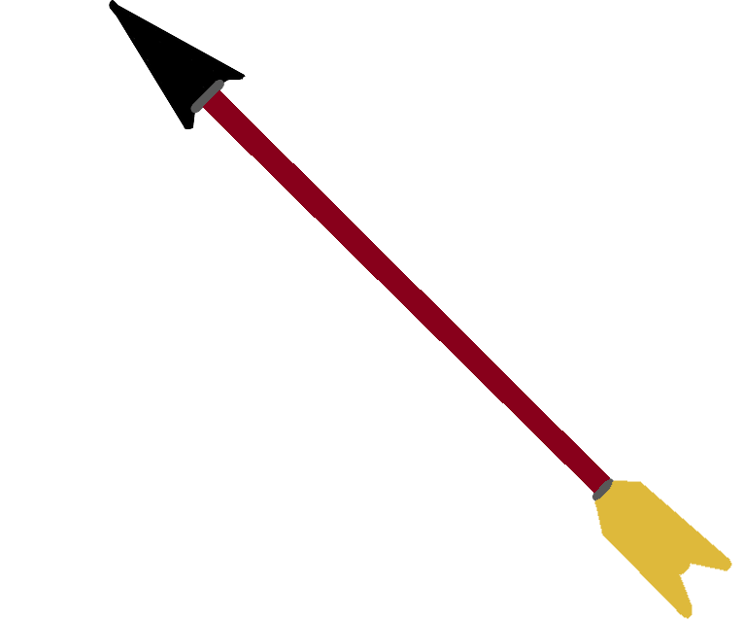
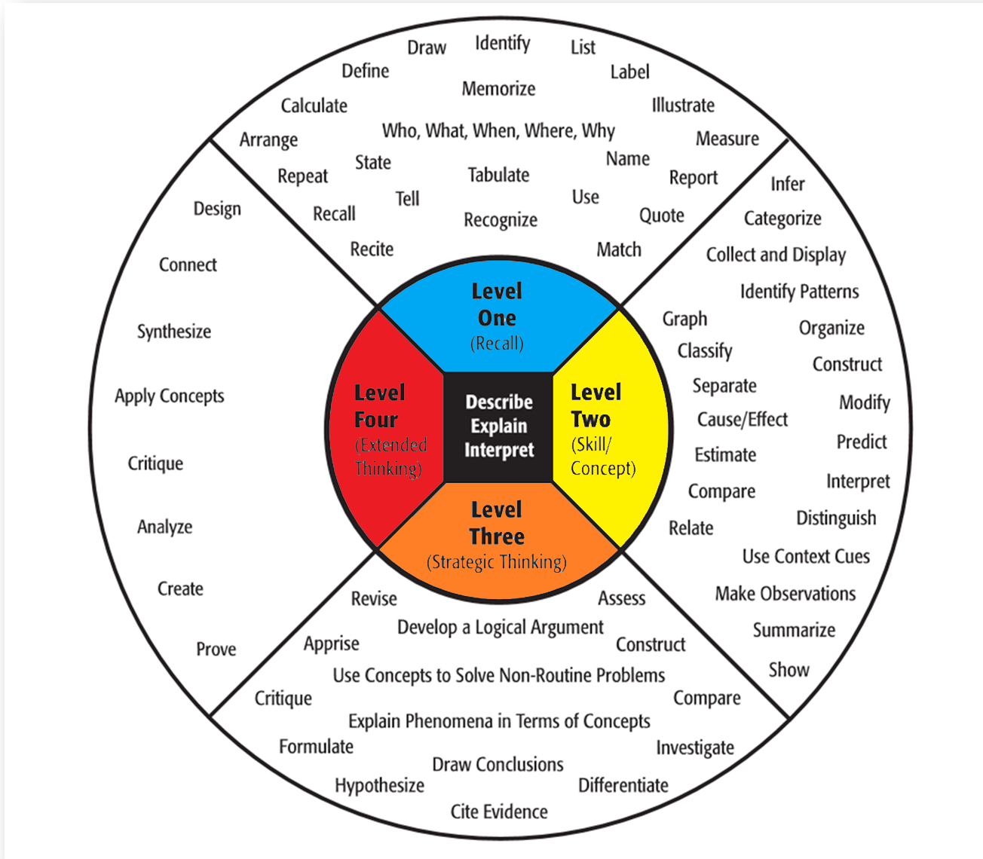
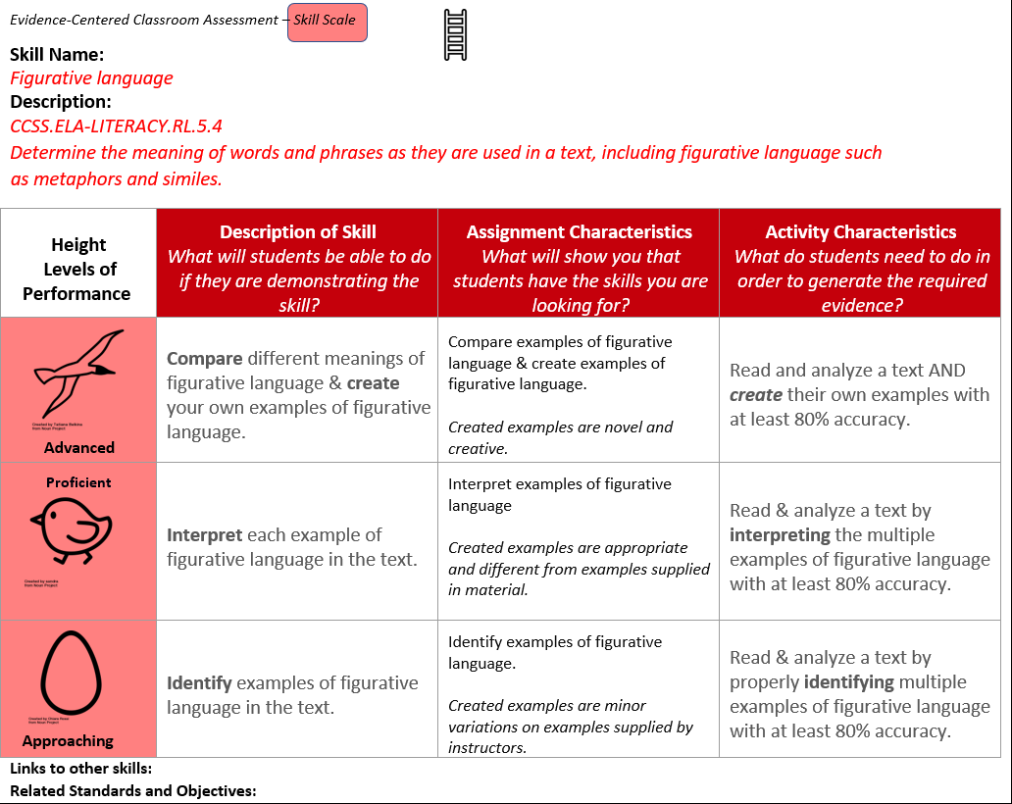
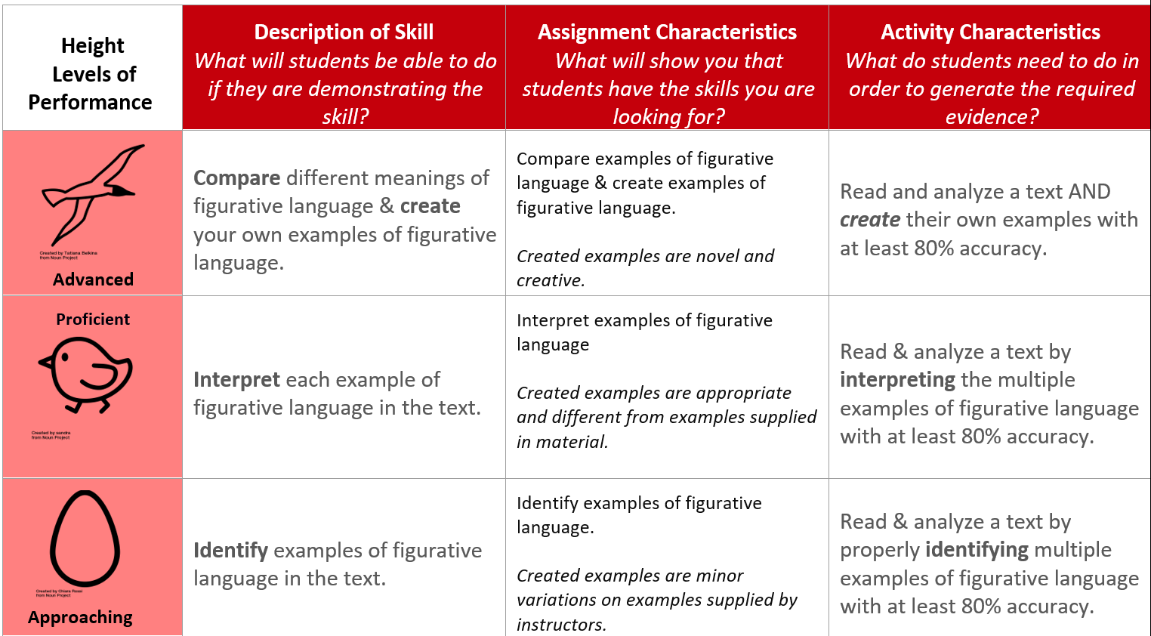
Least Demanding
Moderately Demanding
Most Demanding
More Demanding
Notes:
T- so I am teaching 5th grade English Language Arts, the skill/standard we are working on right now is Figurative language, I want my students to be able to determine the meaning of things like metaphors and similies or my favorite hyperboles. For example, this is the best presentation since Steve Jobs presented the Iphone!
So where do I start?
R – you are on the right track, first you want to determine the skill/standard, in this case you are teaching 5th grade and want to teach figurative language. Next, you describe how the skill looks when a student is approaching proficiency, they are proficient in the skill and when they are advanced in the skill. A good tool to use is the Depth of Knowledge chart. Click next for animation, at level one you can have the students identify (click), level 2 interpret click level 3 to show they are advanced they can compare click and even create new examples of figurative language click hopefully better than my example.
Now how would the assignment in class look like?
Next Slide

Slide 8
Assignment/Activity/Task Example
Sample Student Product
Create 5 figurative language examples
Student Instructions
Identify figurative language such as metaphors and similes in the passage
Interpret figurative language meanings
Showing Proficiency
He was as happy as a pug eating treats. Simile
Create figurative language examples
Not Proficient
Jake was not from Statefarm. Not a metaphor
Notes:
T- well the student could identify the examples of figurative language, interpret those examples and they could also create examples,
R- If we choose the 3rd task create figurative language click
Here a student shows they are proficient with this novel example of a simile
And here’s an example of a student who is being creative but has not quite created an example of a metaphor.
So I see how the students might be approaching, proficient and advanced, but how do we measure this?

Slide 9
Notes:
R- you go back to the skill rubric and set a percentage of accuracy you’d like to see, say the student is supposed to identify 5 figurative language examples, for them to be approach proficiency, they need to get 4/5 of them right to be 80%. So hopefully the student with the Jake from statefarm example has 4 other examples that are accurately metaphors or similes.
Russell’s Rule 1 identified difference

Slide 10
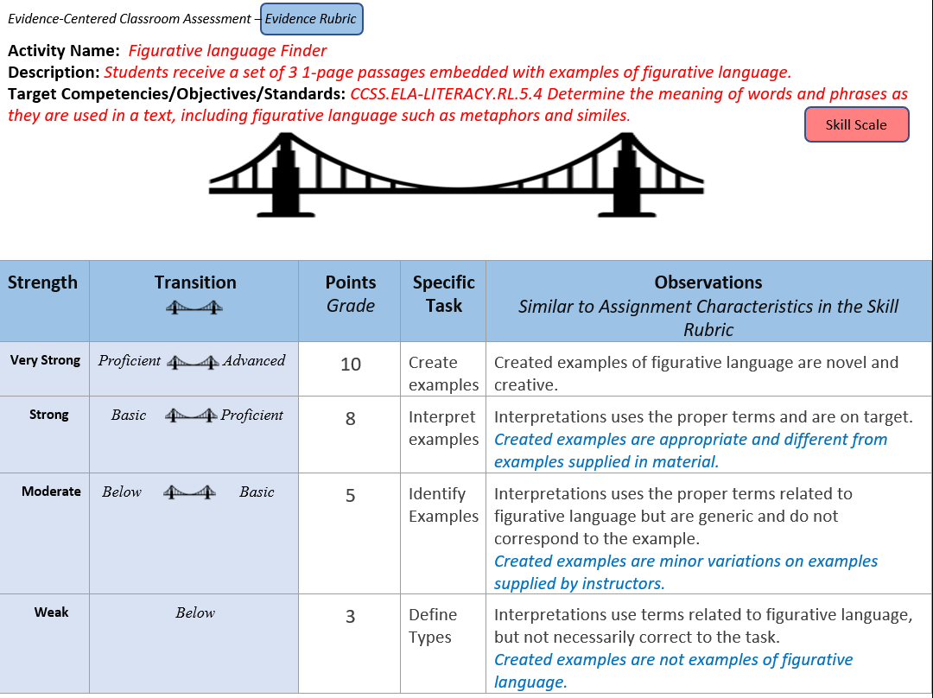
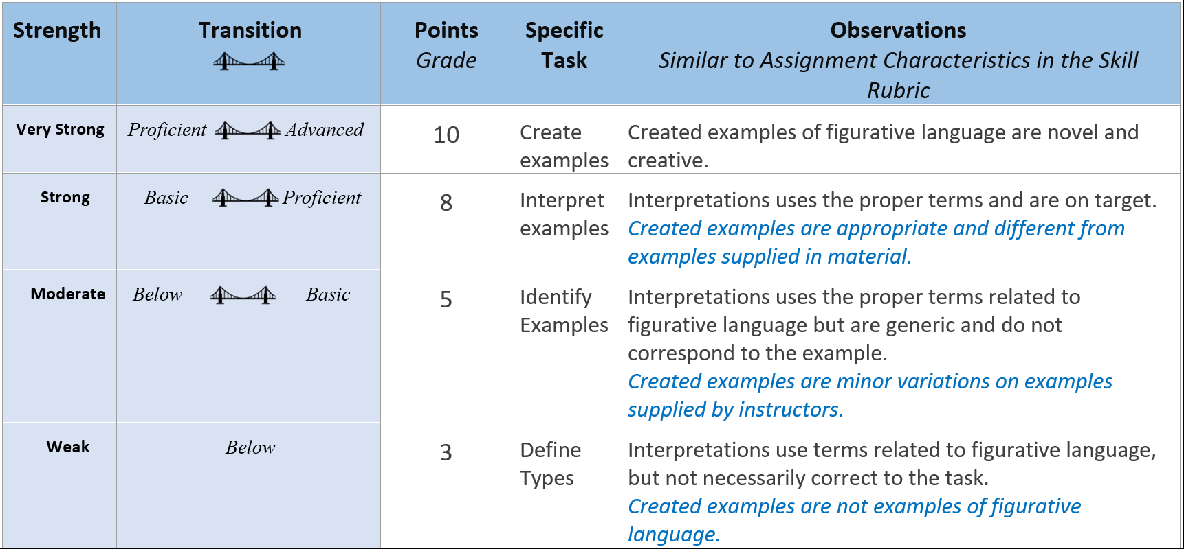
Notes:
R- Continuing on the idea of measuring where your students are on each standard/skill you can create an activity rubric to capture your students’ progress.
T- So I’ve created an activity and I use this as a formative assessment?
R- Exactly, but it also works as your rubric for the activity
T- So I can use this not only to measure how my students are doing, but also grade the assignments and activities they are working on?
R- Now you are getting it
T- So how does this work?
R- first decide out of how many points do you want the assignment to be, in this case 10 is an easy number, then divide that by the 4 categories. Assigning 3 points to students who are trying but are still weak in the skill and below proficiency like the Jake from statefarm example , up to 10 points for students who are very strong in the skill and are proficient/advanced like the pug treats example (these students, if they are commonly getting 10 points may need to have the task be adjusted to be a little more demanding, we will discuss how to do this on the next slide).
Then similar to the previous slide, use the DOK chart to specify the tasks associated with these points and what it looks like when the students are achieving weak to very strong evidence of the skill.

Slide 11
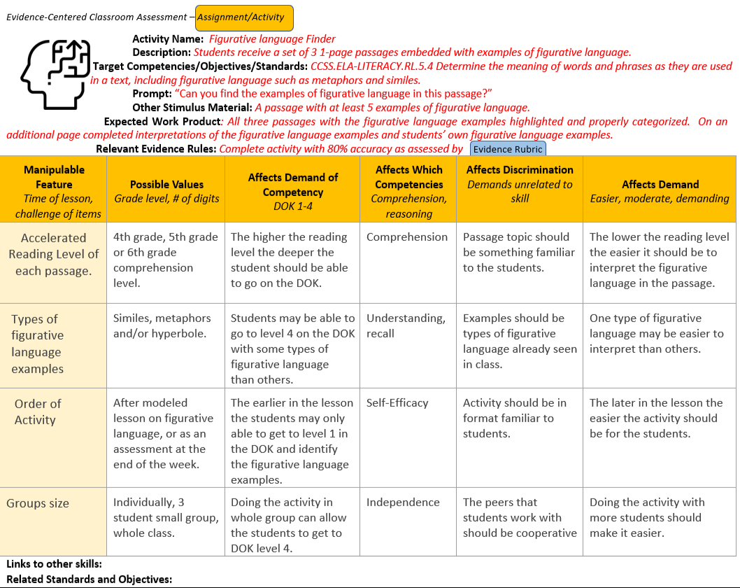
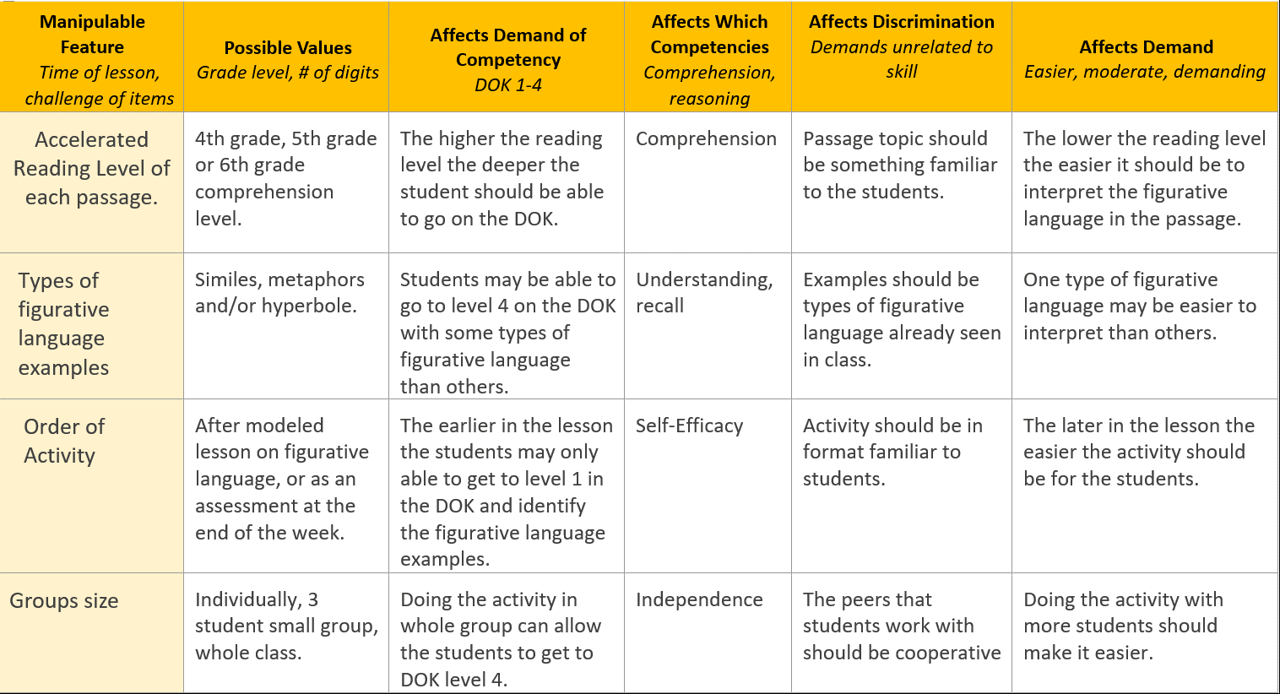
Notes:
T- what happens when my students or student is weak on the skill? I don’t want my student who earned 3 be punished by having them keep that grade, or punish my students who are excelling by earning 10’s by making the tasks harder or more demanding so they get 8 or 5s? But I do want them to master the skill as deep as possible
R- this is where, yes, these tools can be used as grades, but you need to use your discretion, if the student gets a 3, let them try again, and give them the highest grade of each attempt, same with the student that earns a 10, let them try a harder task, but give them the highest grade, or you can do bonus points too
T- whew that’s a relief! Okay, now that you got my buy in, how do I manipulate the task to help students who are struggling and students who make it look too easy?
R- first you consider the different features of the assignment that can be manipulated, maybe it’s the group size of the activity, maybe the activity was individual and too hard for the student scoring 3’s pair them up with another student. What could changing the group size affect?
T- it could help the student move deeper in the depth of knowledge
R- yes it does this by affecting the students’ independence but how?
T- if the peers work together they might be able to have a discussion about the assignment and cooperate with one another to get the answer
R- yes and this affects demand by making it easier. If you need to make the activity more demanding, you could maybe change the type of figurative language from similes to metaphor or analogies for the student easily earning 10s.

Slide 12
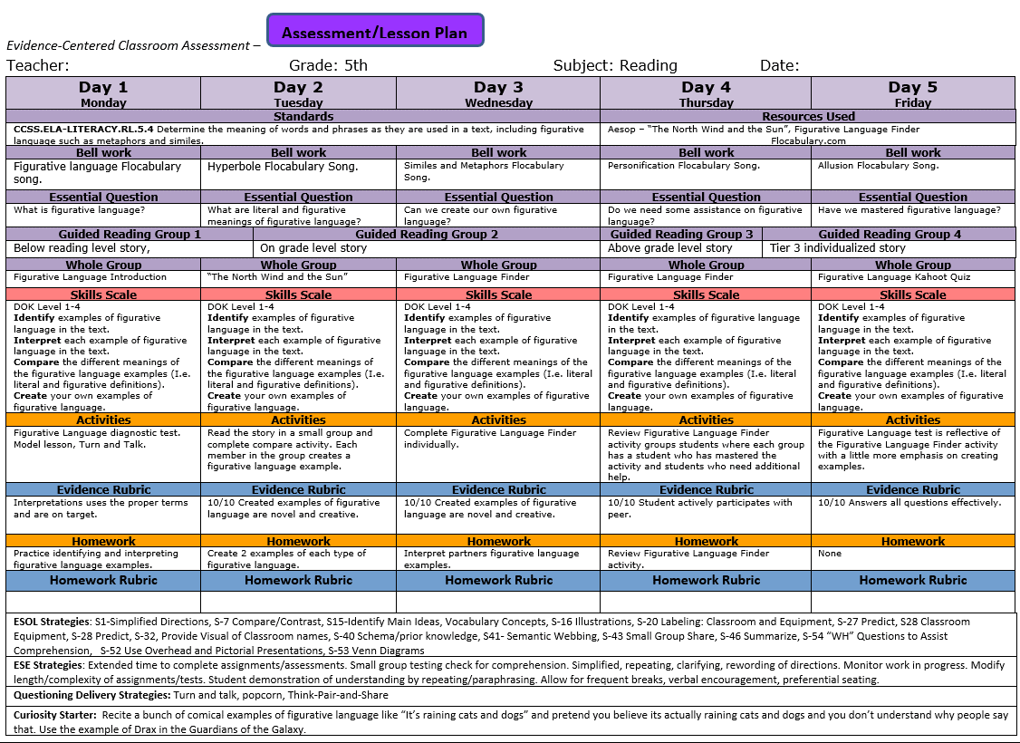
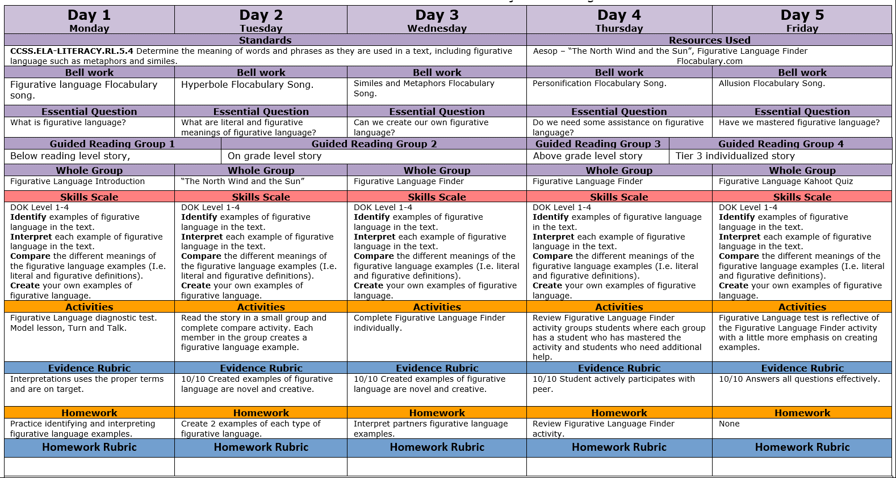
Notes:
T- now as a teacher, I always use lesson plans, how can I incorporate this ECCA model into my lesson plans?
R- Well, I’m aware that the state and district want you to be explicit on the standards you are targeting that week, so you should have them listed on the lesson plan. Now you can add the skills rubric in the lesson plan to keep track of the skills you want your students to achieve. You need to identify the activity you are doing and put the activity rubric so you can make grading easier. This system basically organizes and creates visuals of most of the work an effective teacher would be doing in the first place.

Slide 13
Planning the Four Elements of the Lesson Life-Cycle
Enacting the Four Elements of the Lesson Life-Cycle
Assessment/
Lesson Plan
Skill
Scale
Assessment/
Lesson Plan
Revise Plan
Do Activity
Skill
Scale
Activity Scope
Activity Scope
Gather
Evidence
Identify Evidence
Evidence Rubric
Evidence Rubric
Notes:
T- So we just went through the Four Elements of the Lesson Life-Cycle
R- click yes and now you can see how we move through that cycle as you teach and revise your lessons.
As you plan the four elements of the lesson life-cycle you are going counter-clockwise but as you enact the lesson you are moving clock-wise and in both cases you are constantly monitoring and calibrating the lesson provided the feedback and evidence you are getting from your students by scaffolding the activities accordingly.

Slide 14
Don’t Try This at Home! Try it in the classroom!
Download blank worksheets at
Give us feedback!
Any Questions?
Russell Almond Ralmond@fsu.edu
James A. Hernandez JAH17B@my.fsu.edu
https://pluto.coe.fsu.edu/ECCA
https://pluto.coe.fsu.edu/ECCA
Notes:
T- thank you very much for attending our presentation you can access these worksheets and presentation via the pluto site and email us too!

