Slide 1
Debugging the Evidence Chain
Russell Almond, Yoon Jeon Kim, Valerie J. Shute, & Mathew Ventura
Florida State University
College of Education
Educational Psychology and Learning Systems
ralmond@fsu.edu
¹With lots of help

Slide 2
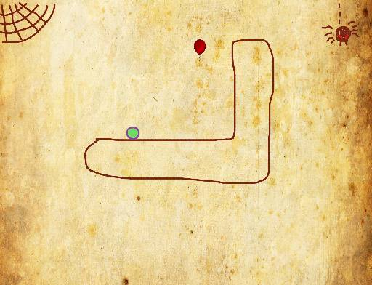
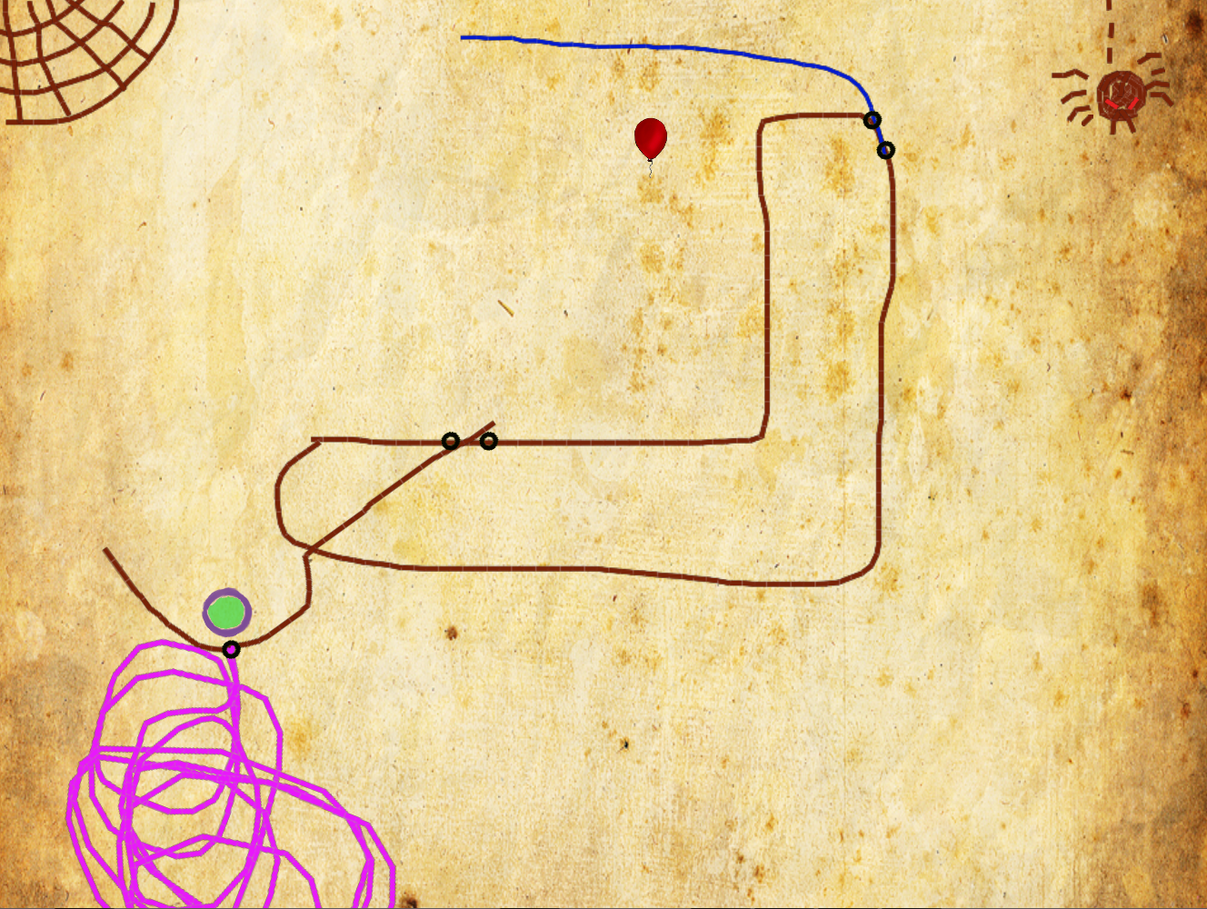
Educational Assessment in a Game: Newton’s Playground
2-D physics simulation game, similar to Crayon Physics Deluxe, based on Box2D physics engine for games
Multiple levels. Goal of each level is to move ball to the balloon by drawing objects that obey the laws of physics

Slide 3
Newton’s Playground Proficiencies Measured
Qualitative Physics
Potential/Kinetic Energy
Angular momentum
Creativity
Fluency
Flexibility
Originality
Conscientiousness
Persistence
Perfectionism

Slide 4
Pilot Test Results
Field trial with about 150 middle school students showed low (around 0.1) correlation between EAP(Physics) [from Bayes net] and short pre/post test on Intuitive Physics
Possible Problems:
Low quality pre/post test (reliability α=0.5 (Form A), 0.4 (Form B)
Problems with design or software
Problems with game level design
Problems with students “gaming” the system

Slide 5
Four Process Model Revisited
Context Determination (Activity Selection): Develop or recognize task contexts
Evidence Capture (Presentation Process): Collect work product
Evidence Identification (task level scoring): Determine values of observable outcomes from work products
Evidence Accumulation: Aggregates observables across tasks to produce scores
In an adaptive system, the task selection/reward structure could be influenced by current “score”

Slide 6
NP: Context Determination
NP is a level-based game
Authoring Game Levels
Coding them with key variables: targeted agents
Eliciting difficulty and discrimination expectations
Grouping them into “Playgrounds”
Testing to make sure levels and game engine work properly.
NP is not adaptive, but as we expect student will normally play through levels in order, need to ensure default sequence provides good evidence mix.

Slide 7
NP: Evidence Capture
This is the game engine
Work product includes:
Record of success/failures/attempts
All objects created and destroyed
Agent identification
Timing information
The log files are sufficient that we can use the game engine to replay any solution attempt

Slide 8
NP: Evidence Identification
Series of Perl Scripts to extract observables from log file.
Key challenges:
Defining observables
Aggregating over multiple attempts at the same level.
Filtering out off-track/irrelevant behavior (“gaming”)
“Gaming” behavior produces noise in agent identification system.
Session-level observables
EI and EA are currently done as post-processing steps on complete data. In future versions of NP they will provide live scoring.

Slide 9
NP: Evidence Accumulation
Bayesian network
Student-specific student model
Level-specific evidence model
Evidence models for all levels share same structure, but custom values for conditional probability tables (parameters)
Can score based on parameters elicited from experts, or try to learn parameters from data:
Data are rather sparse, especially at later levels
“Gaming” behavior introduces noise into the estimation method
Students did not successfully complete many levels, so test-length is short.
Pre-post test is too short and too hard.
Bayes net potentially produces score after observables from each level are absorbed.

Slide 10
Physics Model
Trophy nodes have three possible values: Gold, Silver or None
Can use data from pre/post test as proxy for latent agent knowledge variables
Depends heavily on agent identification system

Slide 11
The “Effective θ ” Method for determining CPTs
Assign values of parent variable a value θ, on a unit normal scale
Pr(Any Trophy| Agent Ability)
= logit⁻¹ 1.7 a_{S} (θ-b_{S})
Pr(Gold Trophy| Any Trophy, Agent Ability)
= logit⁻¹ 1.7 a_{S} (θ-b_{S})

Slide 12
Some typical Numbers
Level | Lever Problem? | a_{Silver} | b_{Silver} | a_{Gold} | b_{Gold} | Mutual Information
Diving Board World | TRUE | 0.90 | 5.04 | 0.024 | 1.97 | 0.000
Smiley | TRUE | 3.37 | 7.26 | 0.002 | 1.48 | 0.000
St. Augustine | TRUE | 0.90 | 5.04 | 0.024 | 1.97 | 0.000
Stairs | TRUE | 11.08 | 10.76 | 0.000 | 0.77 | 0.064
Swamp People | FALSE | 0.12 | 4.78 | 2.431 | 3.69 | 0.033
Ballistic Pendulum | FALSE | 0.90 | 5.04 | 0.024 | 1.97 | 0.000
High slope/intercepts could correspond to convergence problems in model
could just indicate we are the tails of the logistic curve
Use Mutual Information to screen for this case
Low slope indicates that observable is not providing much information:
problematic if this observable is a target of inference.

Slide 13
Histogram of Mutual Information

Slide 14
Evidence Balance Sheets
Show changes in probability (Weight of Evidence) as scoring engine absorbs data from each level
(Earlier levels naturally have more evidence)
Big Jumps indicate that something interesting is going on:
“Gaming” behavior
Nonstandard solutions
Problems with evidence accumulation or identification
Student Learning (possibly)

Slide 15
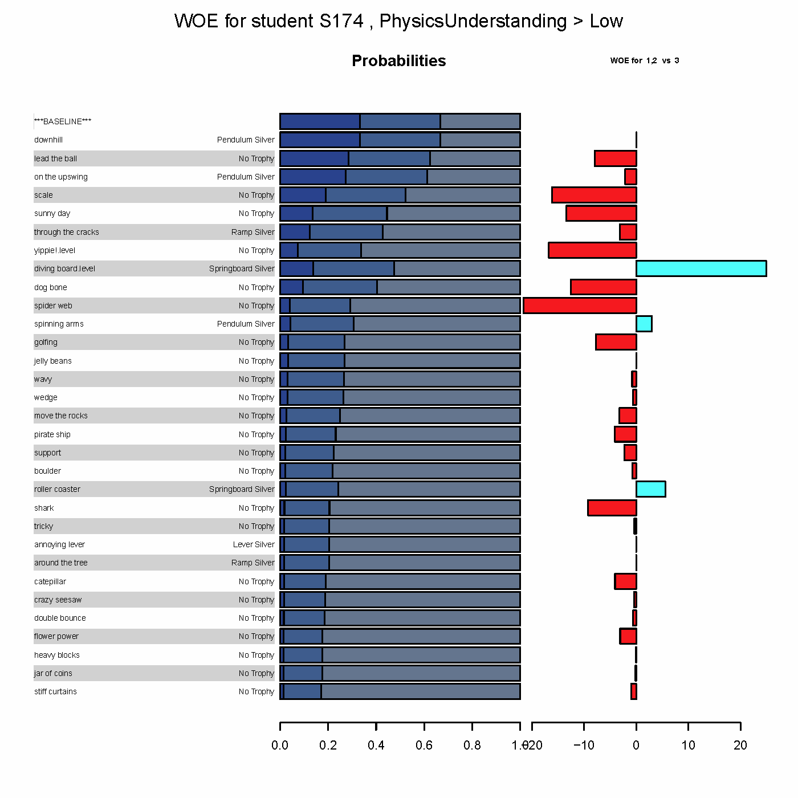
Low Performer
Notes:
This is a fairly typical pattern of a low performer. Mostly negative evidence with lots of slow declines. Not many levels completed.
Note: This person is puzzling because they scored well on the physics pre/posttest but did not do well in the game.

Slide 16
High Performer
Notes:
Fairly typical strong performer. Lots of positive evidence, with some occasional no/low evidence. Lots of gold trophies.
Again, this is a puzzling case as this person scored low on the pre/post-test.

Slide 17
Something strange is going on.
Lots of big jumps associated with silver trophies.
Notes:
This case is showing some anomalous patterns. While performance is mostly going down, there are some occasional successes which cause big jumps in the scores. These seem to be associated with silver trophies.
Next steps would be to view the replays for these levels and see if we can figure out what is going on.

Slide 18
Problems found and fixed
Insufficient weight given to expert priors in building CPTs
Levels where lots of gaming going on:
Screened “gaming” cases out of pretest
Added gaming detection features to engine
Changed scoring rules to emphasize agent construction
Levels with agent partially drawn on screen were problematic
And replaced
Reworked Pre/post tests to make them less difficult
Were able to bring correlations with pre/posttest up to around 0.4 (close to reliability of the pretest)

Slide 19
Thanks
Newton’s Playground team:
Val Shute (P.I.)
Matthew Small
Don Franceschetti
Lubin Wang
Pete Stafford
Bill & Melinda Gates Foundation U.S. Programs Grant Number 0PP1035331 Games as Learning/Assessment: Stealth Assessment

