Slide 1

Transforming Personal Artifacts into Probabilistic Narratives
(UAIW2013)
Setareh Rafatirad and Kathryn Laskey
srafatir@gmu.edu
klaskey@gmu.edu

Slide 2
Outline
Motivation
Agglomerative Clustering
Event Ontology Augmentation
Filtering
Evaluation
Summary

Slide 3
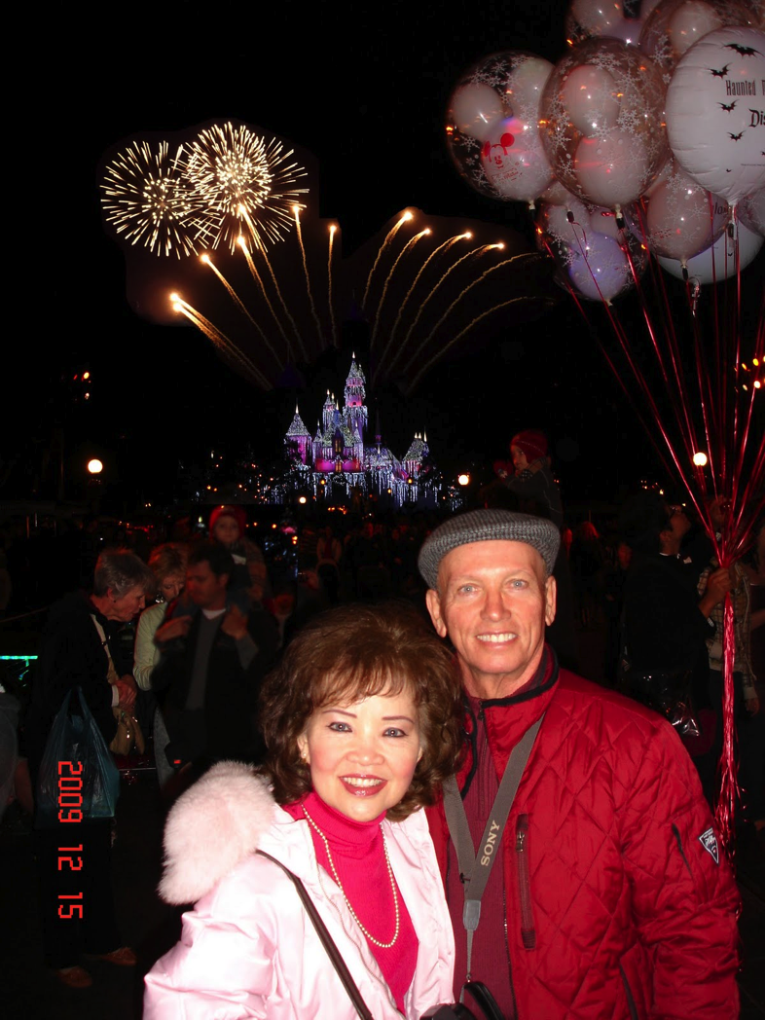
Motivation
EXIF TAG
Date/Time Original : 2009:12:15 11:46:44
Create Date : 2009:12:15 11:46:44
Shutter Speed Value : 1/304
Aperture Value : 2.6
Brightness Value : 7.16
GPS Version ID : 2.2.0.0
Compression : JPEG (old-style)
Thumbnail Offset : 1280
Thumbnail Length : 9508
Bits Per Sample : 8
Color Components : 3
Y Cb Cr Sub Sampling : YCbCr4:2:2 (2 1)
Aperture : 2.6
GPS Altitude : 0 m Above Sea Level
GPS Latitude : 33.81924
GPS Longitude :-117.918963
Shutter Speed : 1/304
Focal Length : 3.8 mm
Light Value : 12.0

Slide 4
Motivation cont’d
Expressive event tag
  Multi-granular Conceptual description
    Containment event relationships e.g. subevent, during, etc.
  Multi-adaptation of Contextual description
    Visit landmark Forbidden City in a trip to Beijing, visit Landmark Washington monument in Washington, DC.

Slide 5
Motivation cont’d
Annotation technique
photo stream annotated with context-adaptive event ontology (probabilistic narratives)
Geo-tagged photo stream of an event +
Ontological Event models
+
Data sources

Slide 6
Domain Event Ontology

Slide 7
Core Event Ontology
Subevent containment Rules:
If subevent(B,A), then:
B.Start>= A.start && B.end<= A.end
Contained-in(B.located-at,A.located-at)
B.media ⊂ A.media
B.participant ⊂ A.participant
E*: A. Gupta and R. Jain. Managing event information:
Modeling, retrieval, and applications. Synthesis
Lectures on Data Management, 2011.
subevent-of
Perdurant
Visual Concept
occurs-at
visual-constraint
Participant
Spatial Region
occurs-during
Endurant
point
Interval
Trel
hasLatitude
end
double:lat
start
hasLongitude
Literal:Timestamp
double:lng

Slide 8
Solution Strategy

Slide 9
Challenges
How to obtain expressive event tags?
How to determine the event category?
What kind of data sources should be used to compute the tags?

Slide 10
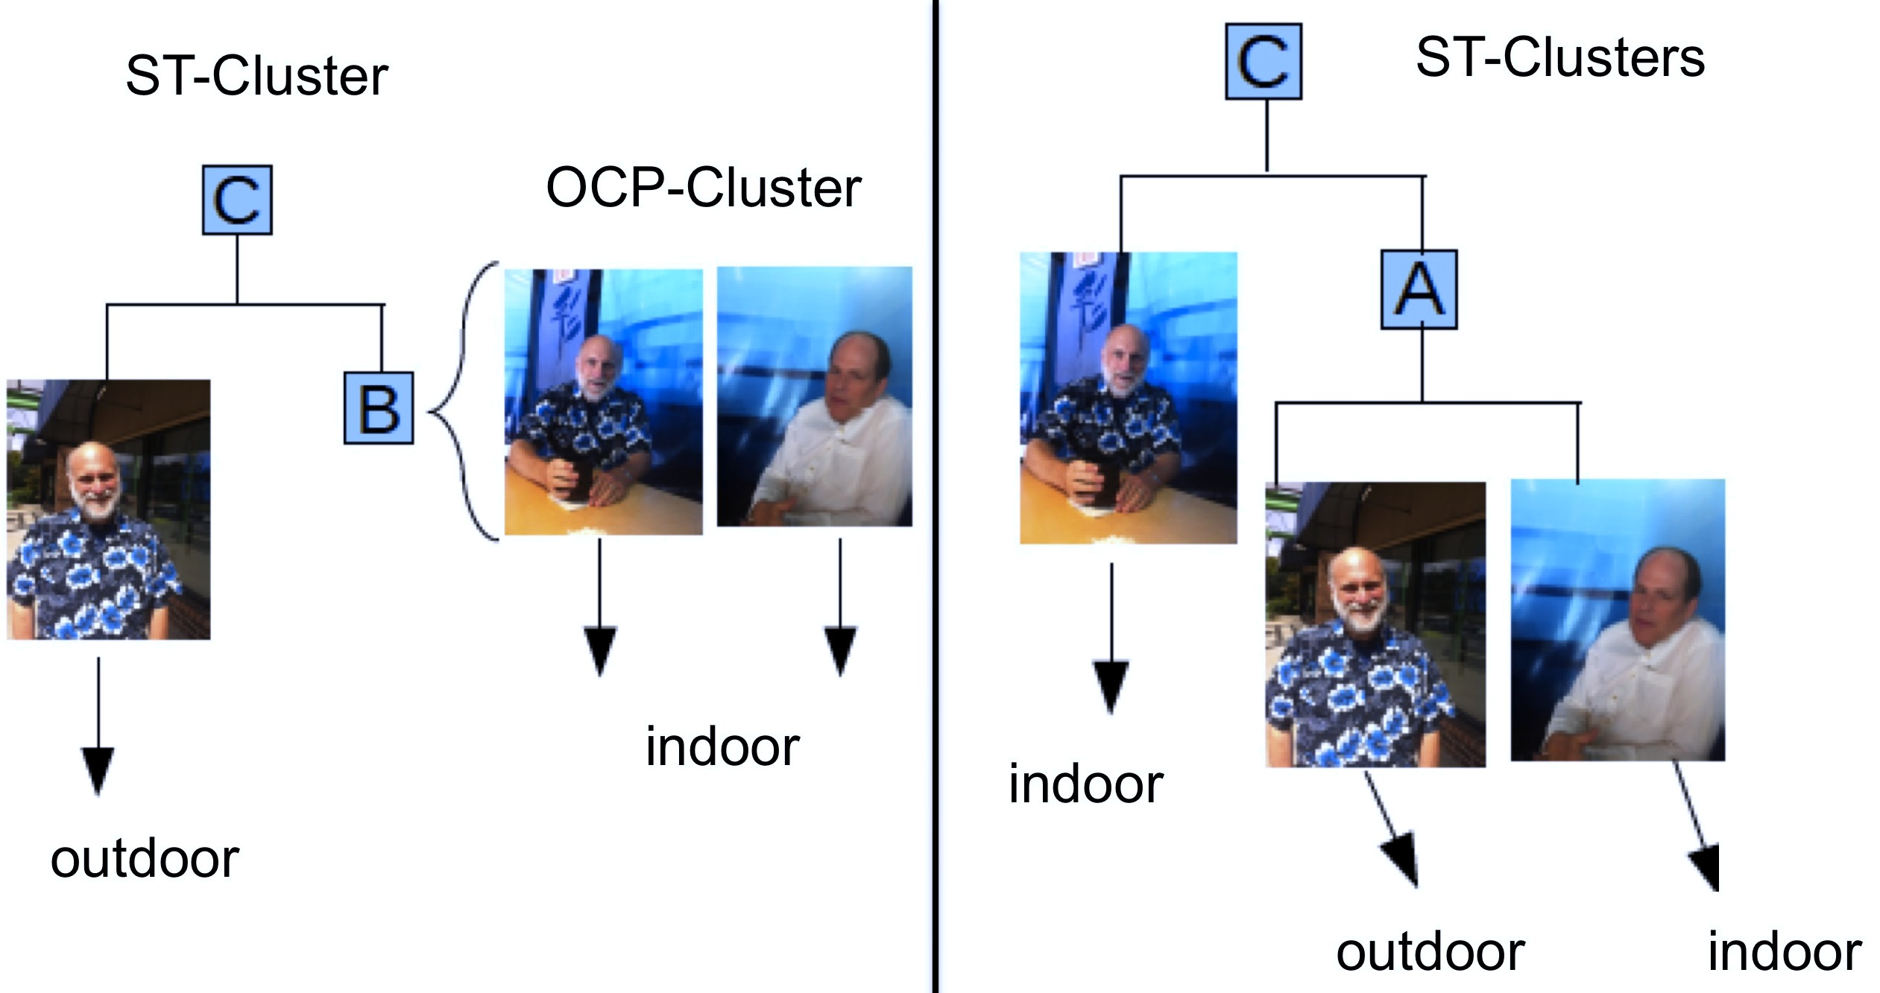
Agglomerative Clustering
Our proposed clustering
SpatioTemporal clustering
vs.

Slide 11
Event Ontology Augmentation
Definition1:
  A context-adaptive event ontology is an instance event ontology, augmented with concrete context cues from disparate sources.
Definition2:
  A tag t for a group of photos C is an augmented instance of a subevent of event E that either exists in event ontology O, or can be derived from O such that t is the finest subevent that can be assigned to C.

Slide 12
Event Ontology Augmentation cont’d
Given a photo pj, find the sound cluster C containing pj
Represent C with a set of consistent descriptors
  using the descriptors of every pi C,
  guided by the descriptors of pj
Confidence of cluster descriptor d:

Slide 13
Event Ontology Augmentation cont’d
Context Discovery
  Schema for source representation
  SPARQL for query sources
weather <typeOf> StatisticalSource
input_attr: (loc,t, zone);
output_attr: (weather);
loc <typeOf> Point;
t <typeOf> Timestamp;
zone <typeOf> TimeZone;
Point <subClassOf> Space;
Point <hasLatitude> Literal:numeric;
Point <hasLongitude> Literal:numeric.
Timestamp <subClassOf> Time;
weather <typeOf> Ambiance;
Ambiance <hasValue> Literal:String;
Ambiance <subClassOf> Quality.
SELECT ?var₁ FROM <source-URI>
WHERE{
attr₁ <typeOf> class_{w}.
attr₂ <typeOf> class_{f}.
attr₃ <typeOf> class_{u}.
?x rel_{a} ?var₁.
?x rel_{b} ?y.
?x rel_{c} ?z.
?y rel_{d} attr₁.
?z rel_{h} attr₂. }

Slide 14
Event Ontology Augmentation cont’d
Descriptors consistency
  Example
outdoorSeating : true;
sceneT ype : outdoor;
weatherCondition : storm
Rule1:
Rule2 is entailed:
inconsistency detected!

Slide 15
Event Ontology Augmentation cont’d
Event Inference
  Find event categories
  Rank event candidates through Measure of Plausibility
    Granularity score for an event candidate
    Context-Plausibility score for an event candidate
    Compare event candidates
  Instantiate and augment the most plausible event candidate
Number of event constraints
Score related to an event constraint

Slide 16
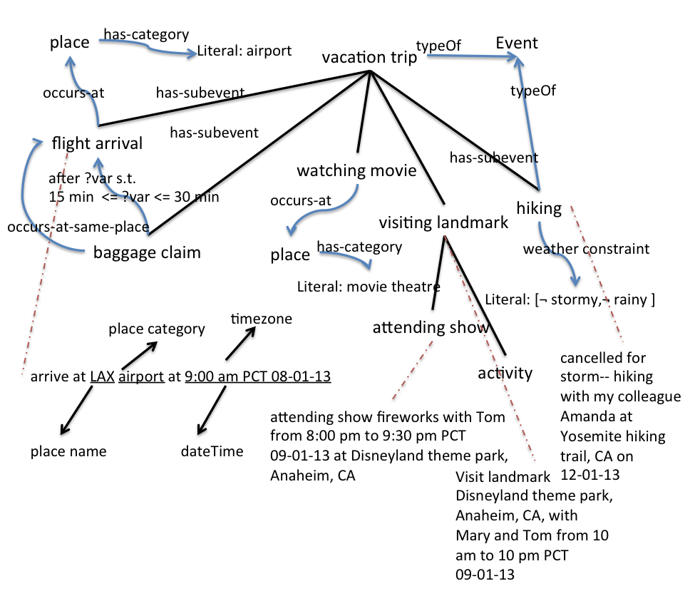
Context-Adaptive Event Ontology (Probabilistic Narratives)

Slide 17
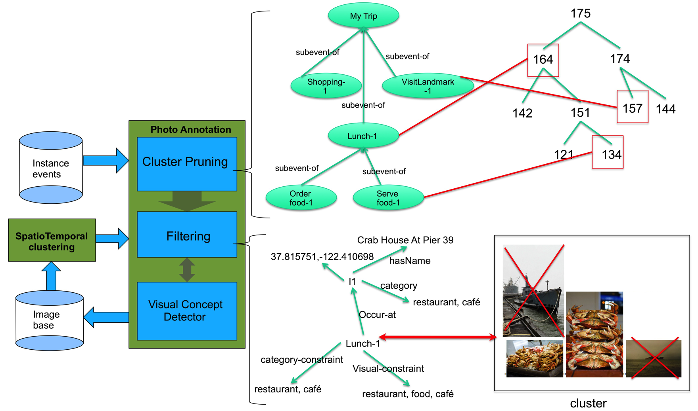
Filtering

Slide 18
Experiments and Evaluation
Formative evaluation
3 domain models
1M photos , 50 Albums from lab and Flickr
Multiple Data Sources
  Trip Advisor
  Google Geocoding
  Yelp
  Upcoming
  Evite
  Facebook
  Wunderground
  Foursquare
  Face.com
  Pictorria (MIT SUN and YELP training set, 500 images/concept, 58 visual concepts, pyramids of color histogram and GIST features-Oliva et al.(2001), Hejrati et al.(2012))
  GoogleMovieShowTimes
  GeoPlanet
  Disneyland.disney.go.com
Evaluation metrics
  Average correctness
  Average Context

Slide 19
Experiments and Evaluation

Slide 20
Experiments and Evaluation
Domain relevancy

Slide 21
Experiments and Evaluation

Slide 22
Summary
Improving performance in terms of quality of tags
Evaluation measure
Event ontology augmentation and information integration
  Automated context discovery
  Relaxation Policies
  Validation using external sources
  Plausibility Measure

Slide 23


Slide 24
Back up slides

Slide 25
Related Work
Event-Centric Models
  Francois et al.(2005),Town at al.(2006), Neumann et al.(2008), Mezaris et al.(2010), Scherp et al.(2009), Gupta and Jain(2011), Masolo et al.(2002), Lagoze et al(2010).
Joint-Context Event-Models
  Viana et al.(2007,2008), Liu et al.(2011), Fialho et al.(2010), Cao et al. (2008), Paniagua et al.(2012).

Slide 26
Event Ontology Augmentation cont’d
Instantiation and augmentation/refinement
  Iteration 1
TA
.
.
.
l1
hasName
WP
l2
GoldenGate
hasName
Alcatraz Island

Slide 27
Event Ontology Augmentation cont’d
Instantiation and augmentation/refinement
  Iteration 1
TA
.
.
.
l1
hasName
hasCategory
…
WP
GoldenGate
Toll Bridge, Historic Site
l2
hasName
hasCategory
…
Alcatraz Island
Prison, Historic site

Slide 28
Event Ontology Augmentation cont’d
Perdurant
Verification
occurs-at
subClass-of
Trip
Spatial Region
subevent-of
subevent-of
My Trip
visitLandmark
Shopping
Lunch
subevent-of
Visit-1
occurs-at
l1
subevent-of
att₁,…,att_{n}
Visit-2
occurs-at
l2
att₁,…,att_{n}

